Slide 1


Understanding health data Perspectives from epidemiology research
Session organized by PandemiX Center, Roskilde University
10:00 – 11:15 October 26th, 2022
Digital Tech Summit 2022

Slide 2
Overview of this session:
Maarten van Wijhe - Assistant professor, Roskilde University Pandemic research: digging through books and bytes Søren Poder - Ph.d.-student, Roskilde University Extracting historical data through Collective Intelligence
Anders Gorm Pedersen - Professor, Technical University of Denmark
Was the 1889 ”Russian Flu” actually a coronavirus pandemic?
Thea Kølsen Fischer - Professor, Nordsjællands Hospital Telemedicine solutions – building our pandemic preparedness and response resilience
Debate Preparing for future pandemics: What did we learn from Covid-19 and what lies ahead?

Slide 3
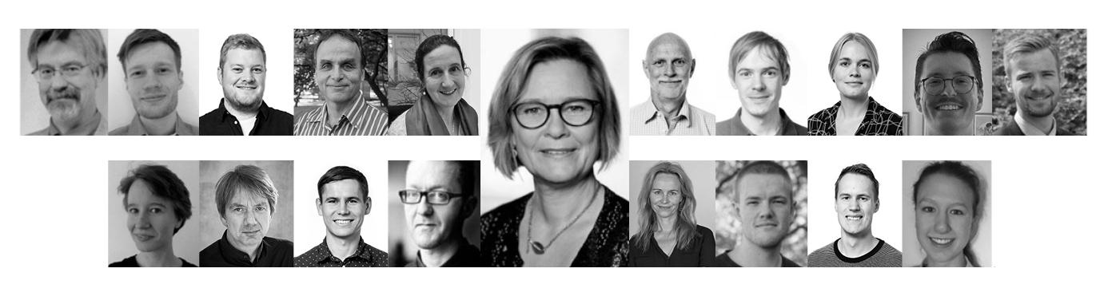





The PandemiX research Center
Made possible thanks to:
Roskilde University

Slide 4


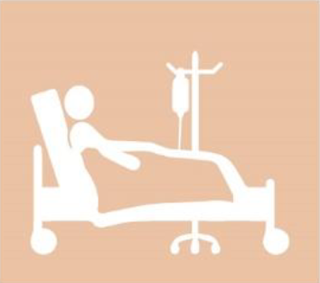
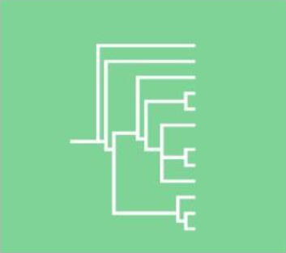
The PandemiX research Center
Infectious disease modelling
Historical epidemiology
Clinical research
Bioinformatics

Slide 5
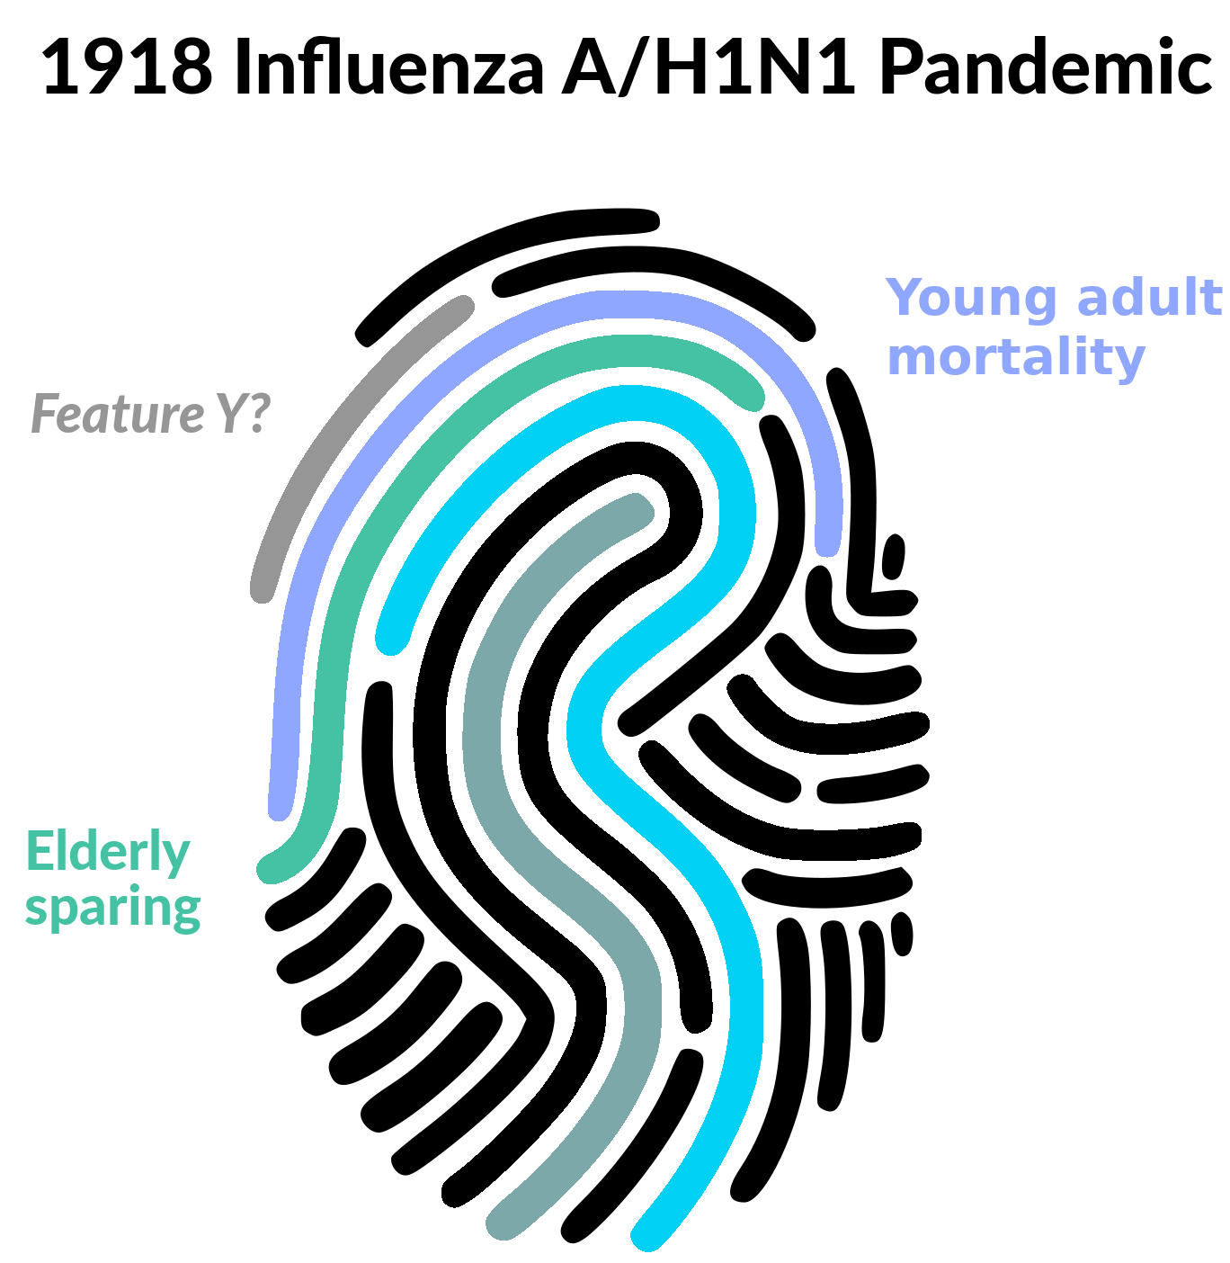
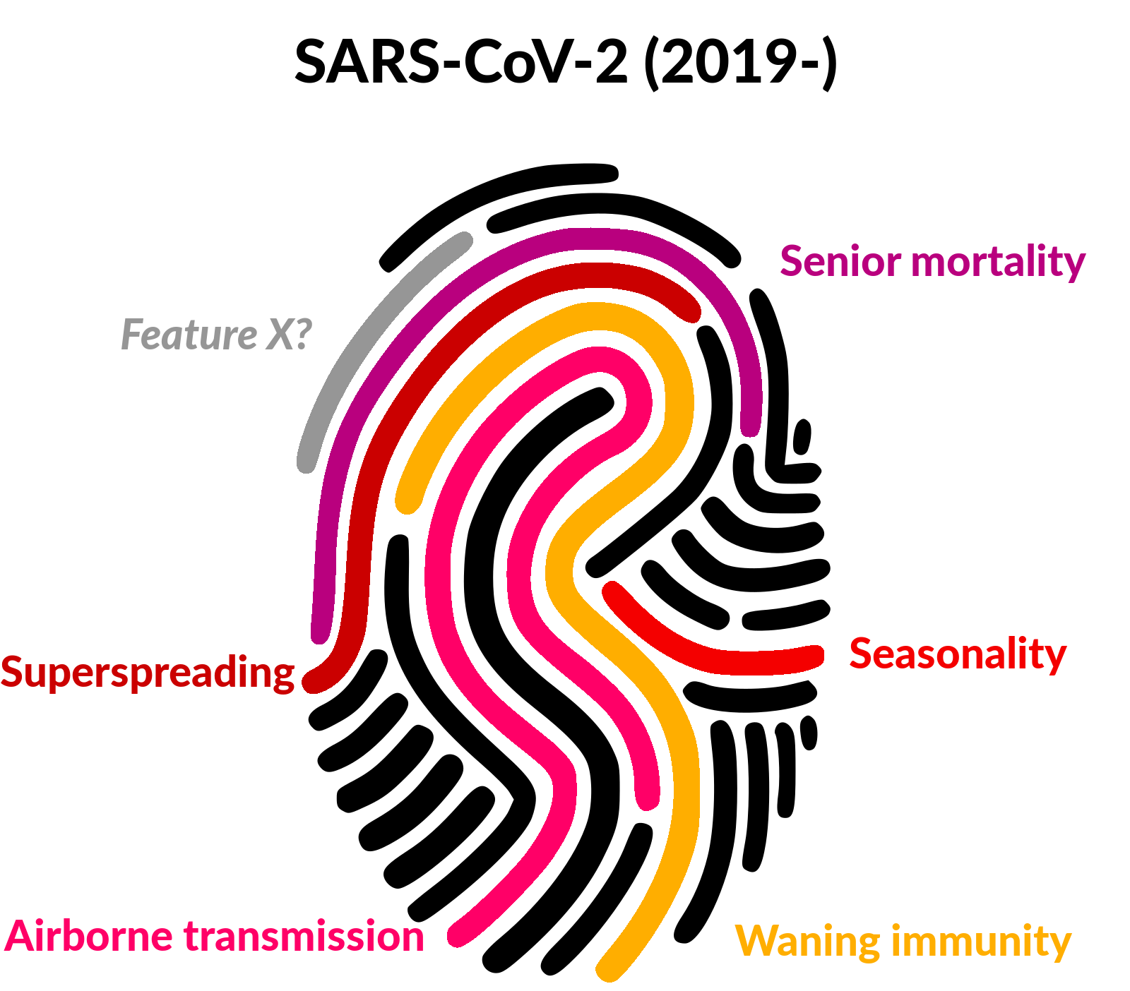

The PandemiX research Center
1918 Influenza A / H1N1 Pandemic
SARS-CoV-2 (2019-)

Slide 6
Understanding health data Perspectives from epidemiology research
Maarten van Wijhe Assistant professor, Roskilde University Pandemic research: digging through books and bytes
Digital Tech Summit 2022

Slide 7
Another pandemic is coming
Corona was not the last, just the latest.

Slide 8
Our long history with pandemics
21st century
20th century
SARS 2003 (near miss)
Influenza 2009
COVID-19 2019-present
19th century
Influenza 1918-1920
Influenza 1957-1959
Influenza 1968-1970
HIV/AIDS 1981-
Pre-19th century
Cholera 1817-1899
Influenza 1831
Plague 1855
Influenza 1889-1891 (?)
Plague of Justinian 541-544
Black death 1346-1352

Slide 9
Our brief history with pandemic data
Data availability
21st century
20th century
SARS 2003 (near miss)
Influenza 2009
COVID-19 2019-present
19th century
Influenza 1918-1920
Influenza 1957-1959
Influenza 1968-1970
HIV/AIDS 1981-
Pre-19th century
Cholera 1817-1899
Influenza 1831
Plague 1855
Influenza 1889-1891 (?)
Plague of Justinian 541-544
Black death 1346-1352

Slide 10
What can past pandemics teach us?
01
Signature features
02
Unsolved mysteries
Each disease has its own characteristics; age patterns, seasonality, infectivity, ….
Mysterious outbreaks with high impact of which we do not know the cause… but may hold vital information for the future
(climate change, re-emergence)
03
Critical questions
04
The coming storm (again)
Why were the elderly spared during the 1918 pandemics?
What can we expect from mitigation strategies?
We know another pandemic is coming, how can we best prepare, how can we make better models?

Slide 11
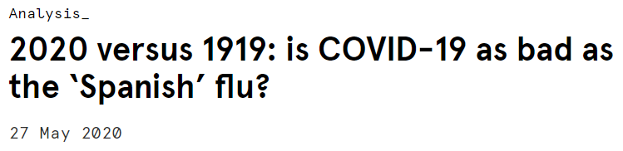
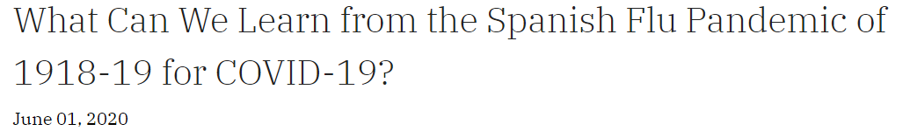
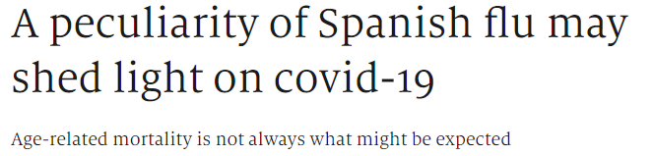
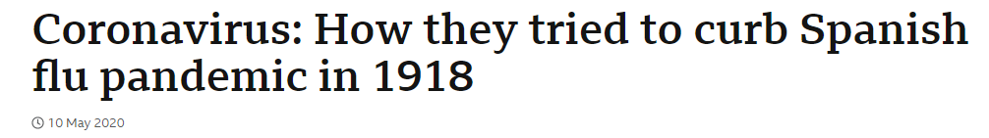
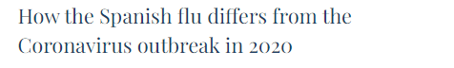
Source: stlouisfed.org
Source: Sydney.edu.au
Source: economist.com
Source: BBC.com
Source: ourworldindata.org

Slide 12
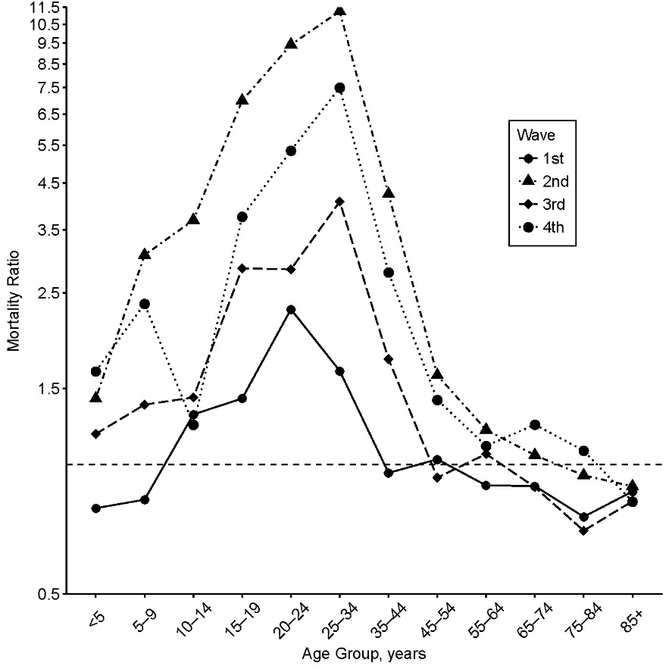
Excess mortality 1918 pandemic, Copenhagen
Peaks around 25-34 years of age, and drops to near zero around 45.
Elderly are spared… But why?
Possible protection from previous pandemics?
Russian flu in 1889-1890?
Poultry outbreak in 1872?
Van Wijhe et al, AJE 2018

Slide 13
Find old data in libraries and repositories
Digitize relevant data
Curation and management
Data analysis
Often these data are in paper reports, or scanned documents online.
Using excel and OCR programs we digitize any data that may be relevant for the topic.
Data is cleaned of errors and readied for analyses.
Using mathematical and statistical tools from epidemiology and demographics.

Slide 14
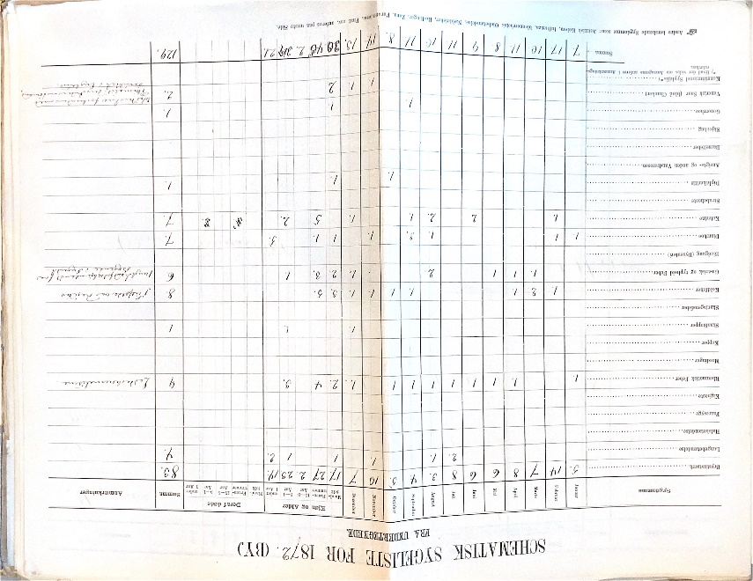
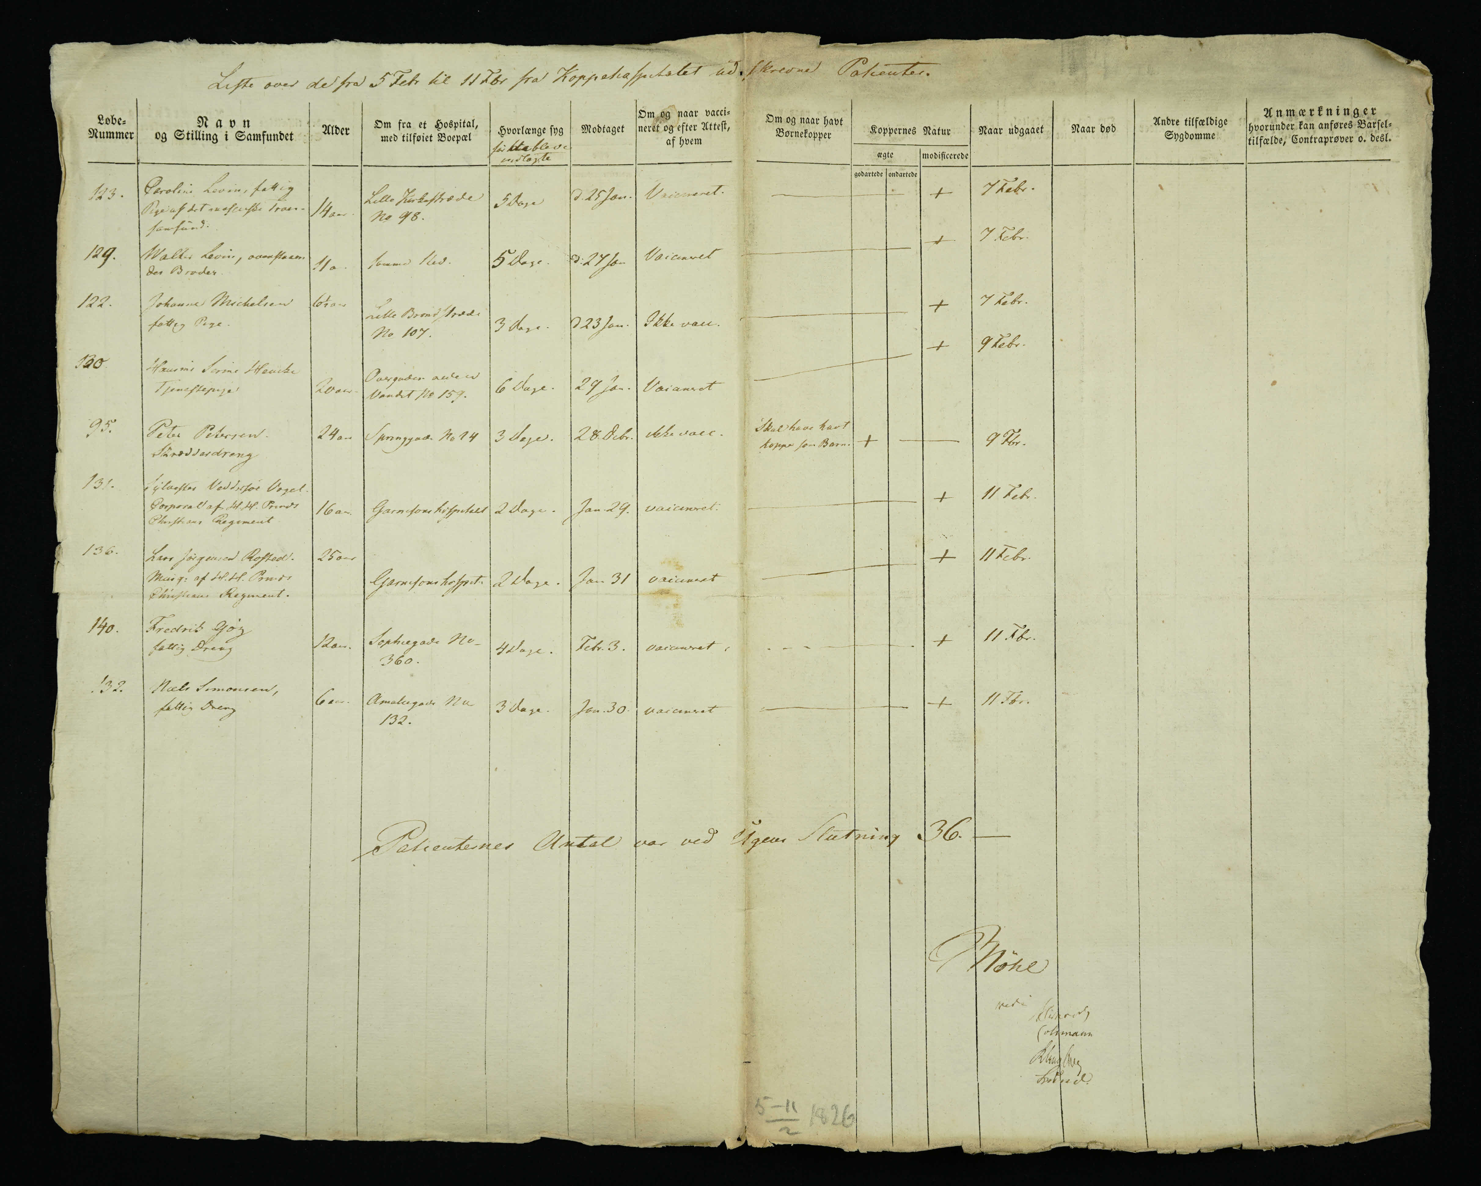
Odense
Søkvæsthuset, CPH
1872, city
1826-27, smallpox hospital
Sometimes the records contain handwritten notes.
Admitted patients, handwritten but structured.

Slide 15
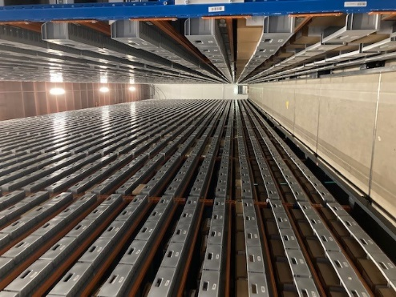
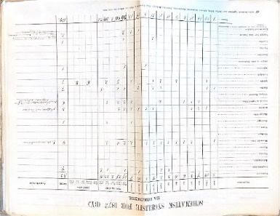
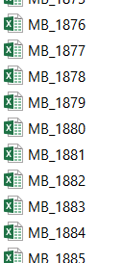
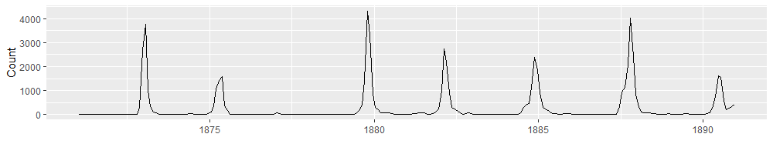
Find relevant documents
Locate the physical documents
Scanning / digitization
Scan the physical documents
Transcribing
Entry of data into templates / databases
Curation and database construction
(~180.000 rows of data for just 20 years)
Error checking, standardization, meta data, FAIR
Medicinalberetninger: Measles in Copenhagen 1871-1890

Slide 16
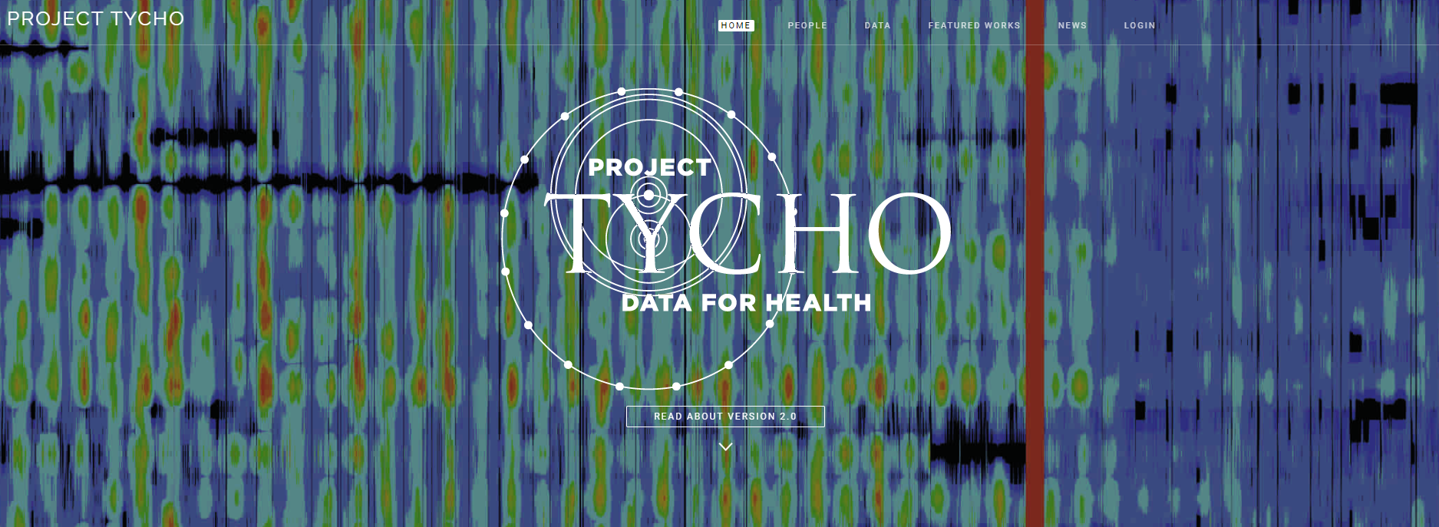
Weekly notifications of diseases from US cities 1888 - 2017
Digitized by hand, 35000 excel spreadsheets, 6300 files, 200 million keystrokes
All available online, updated continuously
As of 20-10-2022: 23500+ downloads, 75+ publications, 1.300.000+ API calls.
Tycho.pitt.edu; van Panhuis et al, NEJM 2013

Slide 17
There are only so many pandemics to study, only so many to learn from…
But databases with historical data are still lacking
Technical solutions to data entry. How can we make this process easier? OCR? Citizen Science?
A need for open-access repositories
Funding…

Slide 18
Understanding health data Perspectives from epidemiology research
Søren Poder Ph.d.-student, Roskilde University Extracting historical data through Collective Intelligence
Digital Tech Summit 2022

Slide 19

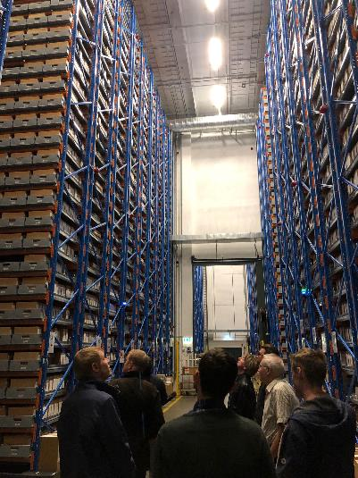
Imagine a digital past
Accuracy
Completeness
Validity
Consistency
Uniqueness
Integrity
We Wish
Notes:
Imagine you want to understand the 1918 Pandemic – the so-called Spanish Flu that estimated infected half the world’s population killing an estimated 75 million people (about twice the population of California) in less than four months. Not because history is exciting, as I as a historian anytime will claim, but simply because you want to recreate and historical experience that is comparable to the experience with the 2020-pandemic – known as Covid.
A backdrop of knowledge and data to play ball with if you like in hope of combating the next pandemic. That is not just in the interest of historians although we love to say “I could have told you”
What would you need? Data – and a lot if!
Luckily, we got a lot of it. Denmark is one of very few countries in the world that have so much data on basically all individuals that have been born, lived, and died within the borders of the Kingdom in the last almost 250 years. Prior to the 1820’ies, the information get gradually more fractured and random.
Danish archives hold literally hundreds of kilometers of records of data – in paper format. Often handwritten and therefore inaccessible. An even more so – for most unwritable! In short, before we can hope to have a scalable dataset, we are looking at painstaking years of transcription.
Within the next few minutes, I’ll tell you a story about how a research project on the 1918 pandemic went from a micro epilocila research project to also including a bid on how traditional crowdsourcing could incorporate as one part of a Collective Intelligence scheme that will accelerate the data collection process without compromising the paramount demand for Accuracy. There might be a difference between pneumonia in one lung and double pneumonia.
I will not go into how we a taken this model further into the realm of Hybrid Intelligence.

Slide 20
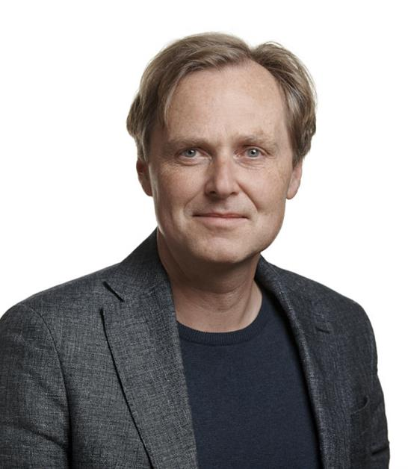
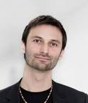
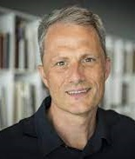
When I say “We”
Christian Møller Dahl. Professor of Economics
Co-founder & COO at Rooftop Analytics ApS.
University of Southern Denmark
Jacob Sherson. Professor MSO.
Founding director of Center for Hybrid Intelligence and ScienceAtHome.org, Prof. MSO
Aarhus University
Søren B. Christensen. Municipal Archivist, Ph.D.
Aarhus City Archives
External lecturer
Aarhus University
Notes:
However, before we proceed, I’ll like to say that when I say we it is not net because I suffer from a multiple personality disorder, but simply because the following technology, theories, and perspectives have been developed in a close corporation with the three very gifted gentlemen seen here.
Each has contributed at different stages and added vital knowledge, thoughts, and technology to the collective Intelligence part of the project.

Slide 21
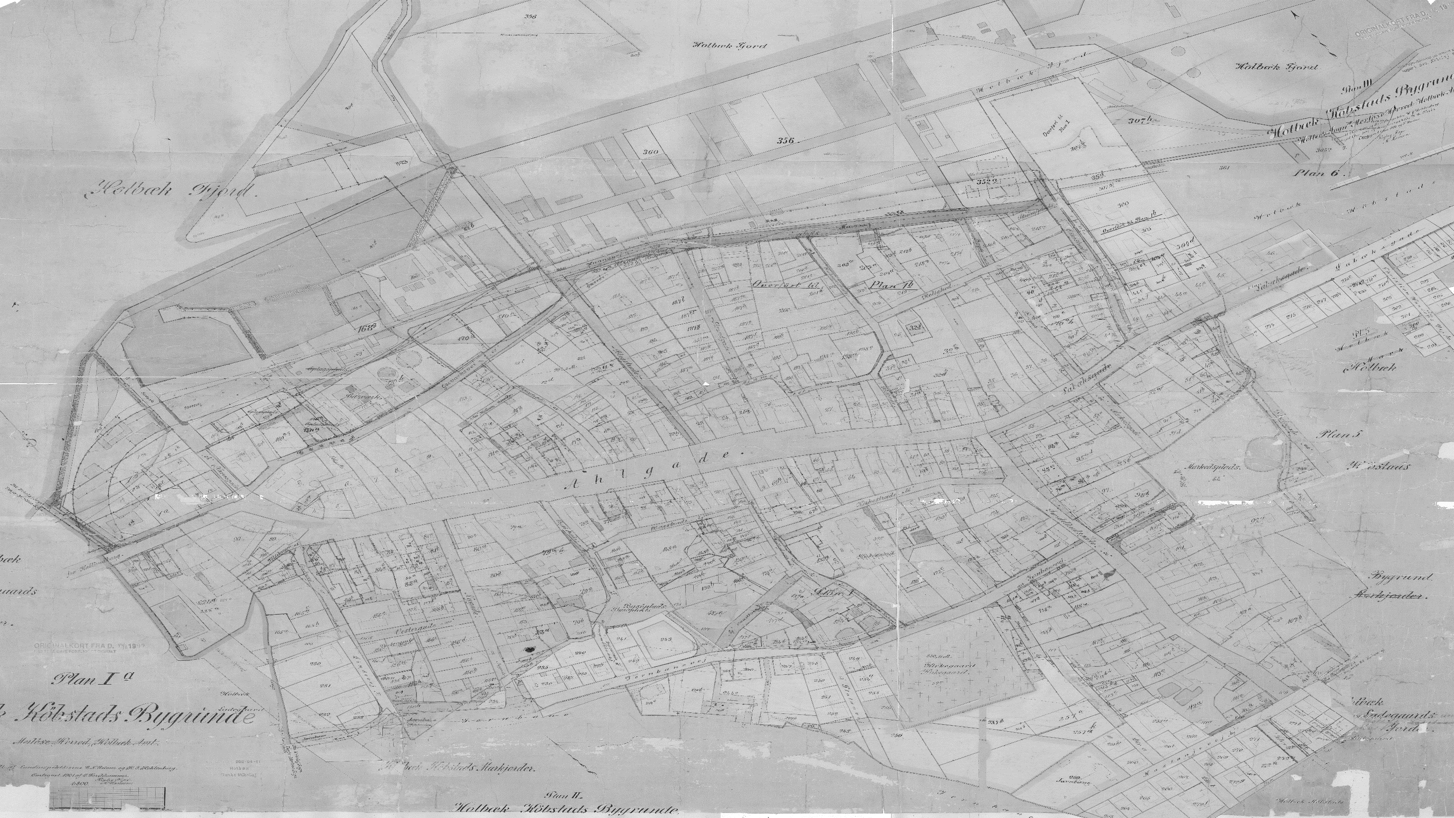
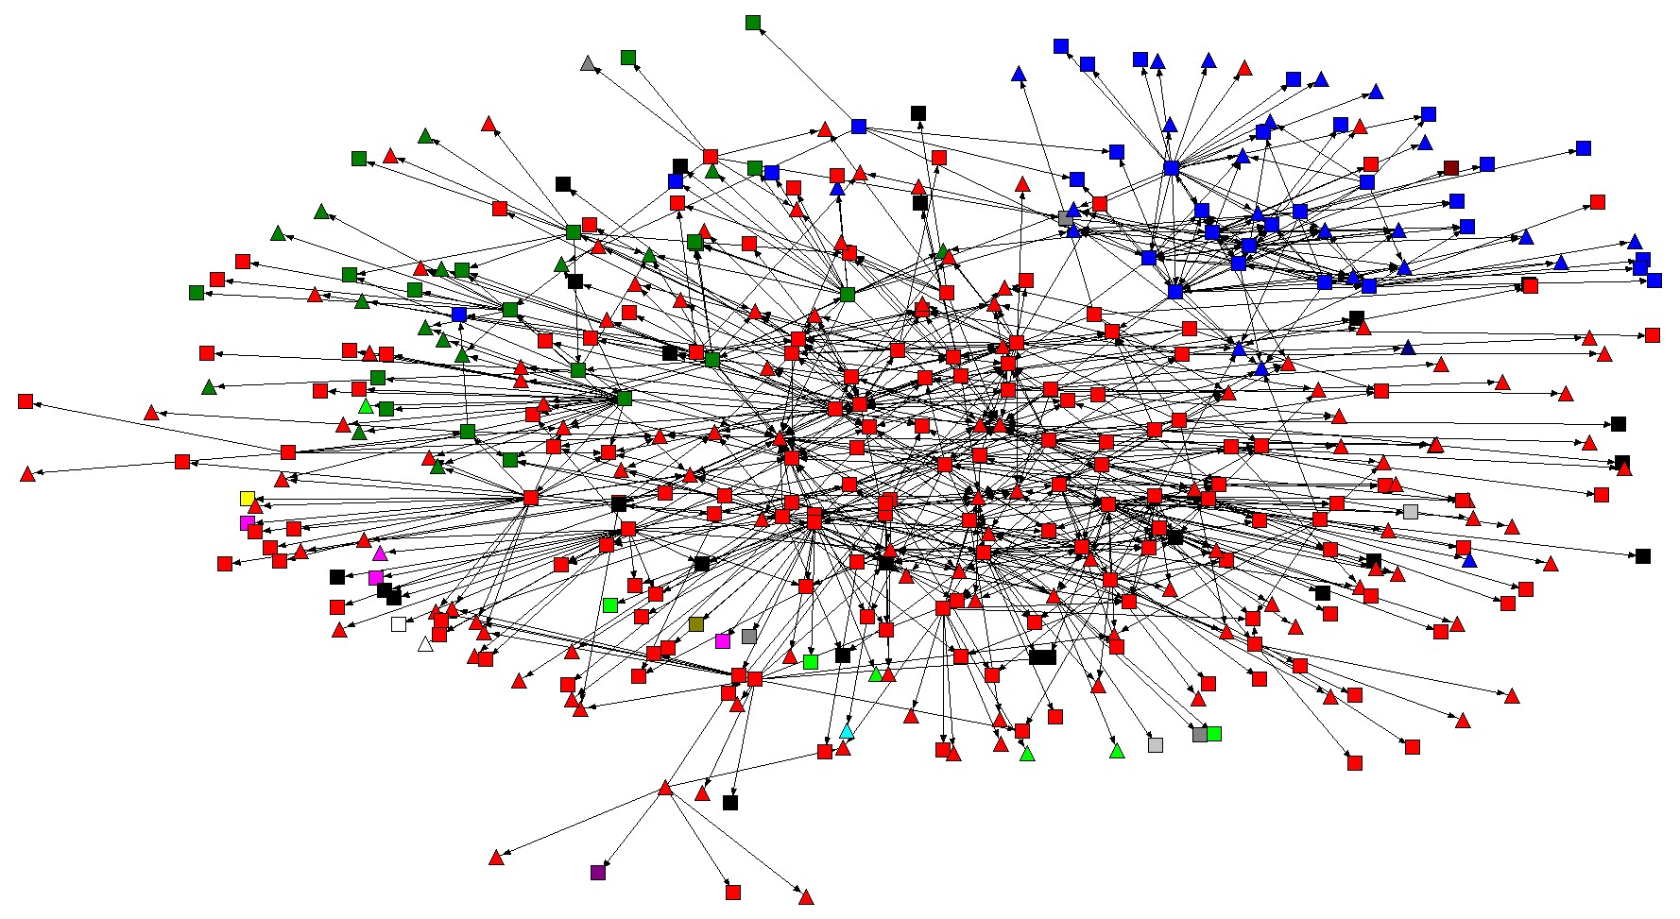
The 1918 Pandemic
Lessons Learned from 1918

Slide 22
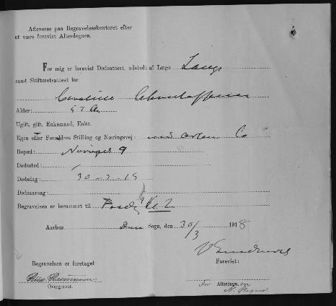
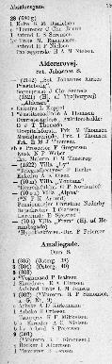
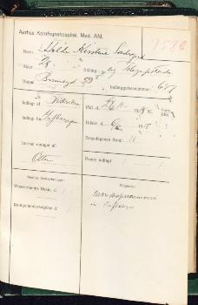
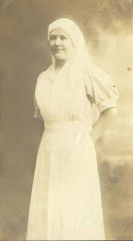
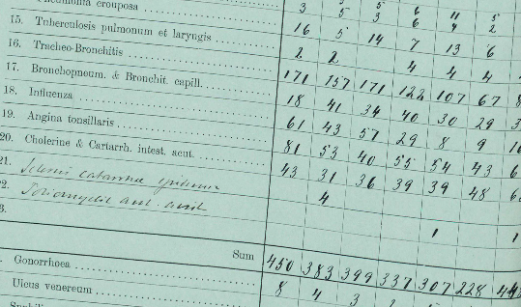
Collecting and Linking the Data
200 Medicinal reports
1500 Pages of tabulated incidents rapport
3.500 Deaths certificates
4.000 Hospitals Admissions
7.000 Patient Records
4.500 Household Statement (~74.000 individuals)
14.000 School Admissions
Entities to be transcribed:
> 500.000

Slide 23
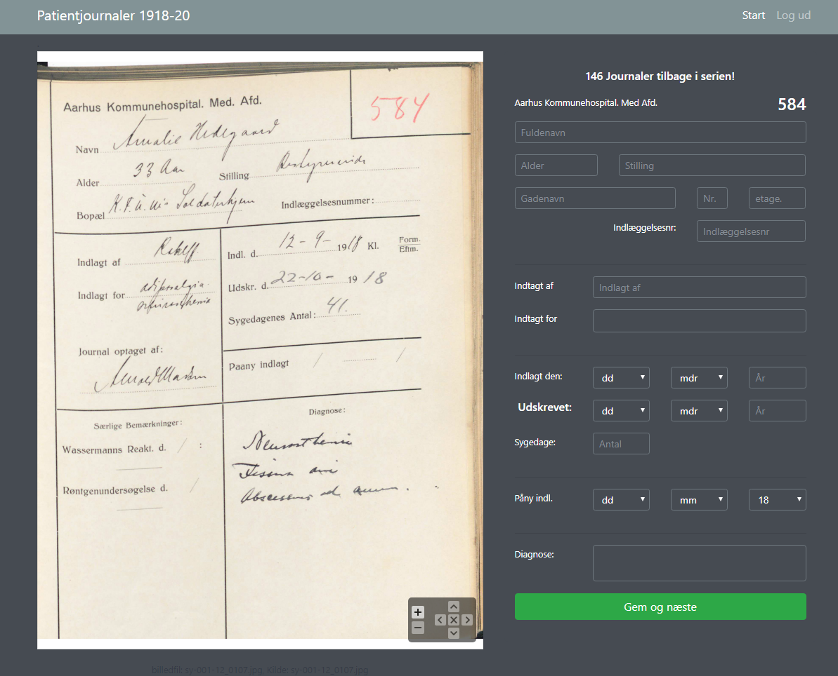
Take One
Entities to be transcribed:
> 500.000
If Accuracy is an Issue
> 1.000.000 individual tasks
Notes:
Let us start with the Patient Records. And focus on the front page – not the content, for that’s a very different story. A patient record from 1918 looks like this. You see the name, address, age, etc. of the admitted patient. When the patient was admitted when he or she was discharged or dead. And finally, the doctor's diagnosis’ Not only is the records handwritten they are drawn up by medical doctors.
To transcribe the vast amount of data we decided to go with crowdsourcing. That is a platform where volunteers are invited to transcribe historical documents or annotate images etc.. Some of you might know about the Zooniverse Platform.
So as the convention dictates, we developed a platform like this - and ask volunteers to help us out. Our marketing argument was “it’s not a question is not if, but when the next pandemic will hit”. Little did we know in 2017.
And here we go. Almost as easy as locating what you looking for in IKEA.

Slide 24
Accelerating Return on Investment …
Many
CS2
CS1
Few
Time
… without compromising data accuracy

Slide 25
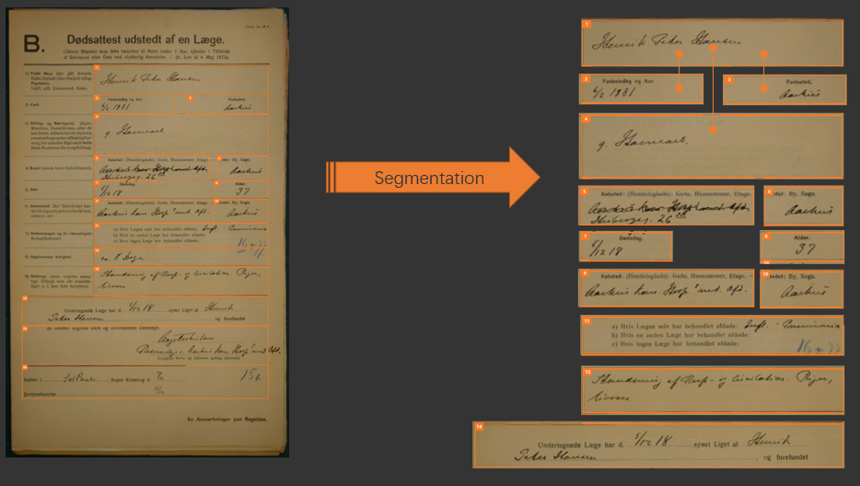
Take Two
Metadata
Segment: Person
DocumentID 123456
Type: DeathCertificat
Coordinates: X,Y
Value: Henrik Peter Hansen
“Free information from the container it came in”

Slide 26
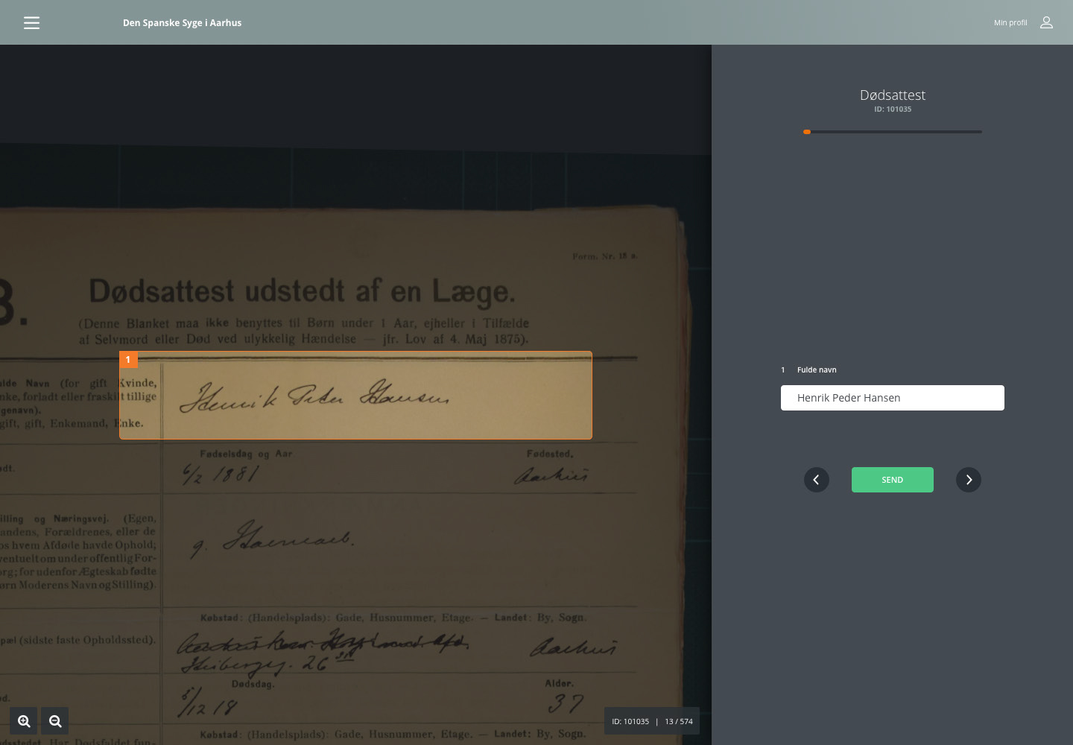

Take Two - Frontend
Specific
Measurable
Achievable
Realistic
Timebound
Microtasks!
Notes:
So back to the drawingboard

Slide 27
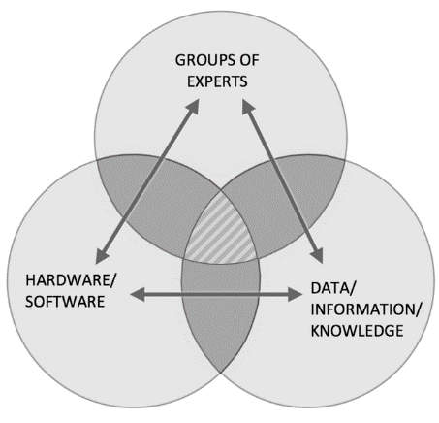
Human-Computer-Interaction:
Collective Intelligence
and perpetual learn from each other
individual
“A process by which a large group of individuals collaborate with machines to gather and share their knowledge, data and skills for the purpose of solving societal issues.”
Notes:
)Imagen

Slide 28



Thank You
Søren B. Christensen, Municipality Archivist, Ph.D.
Aarhus City Archives
Associate Professor
Aarhus University
Christian Møller Dahl, Professor of Economics
University of Southern Denmark
Co-founder & COO at Rooftop Analytics ApS.
Jacob Sherson. Professor MSO.
Founding director of Center for Hybrid Intelligence and ScienceAtHome.org
Aarhus University
Lone Simonsen, Professor, Department of Science and Environment, Mathematics and Physics (IMFUFA)
Founder and director of PandemiX Center
Ole Sonne. Associate Professor Emeritus, Med.Sc.D. Ph.D.
Aarhus University
Anne Thomassen, Former Medical Director
Aarhus University Hospital

Slide 29
Understanding health data Perspectives from epidemiology research
Anders Gorm Pedersen Professor, Technical University of Denmark
Was the 1889 ”Russian Flu” actually a coronavirus pandemic
Digital Tech Summit 2022

Slide 30
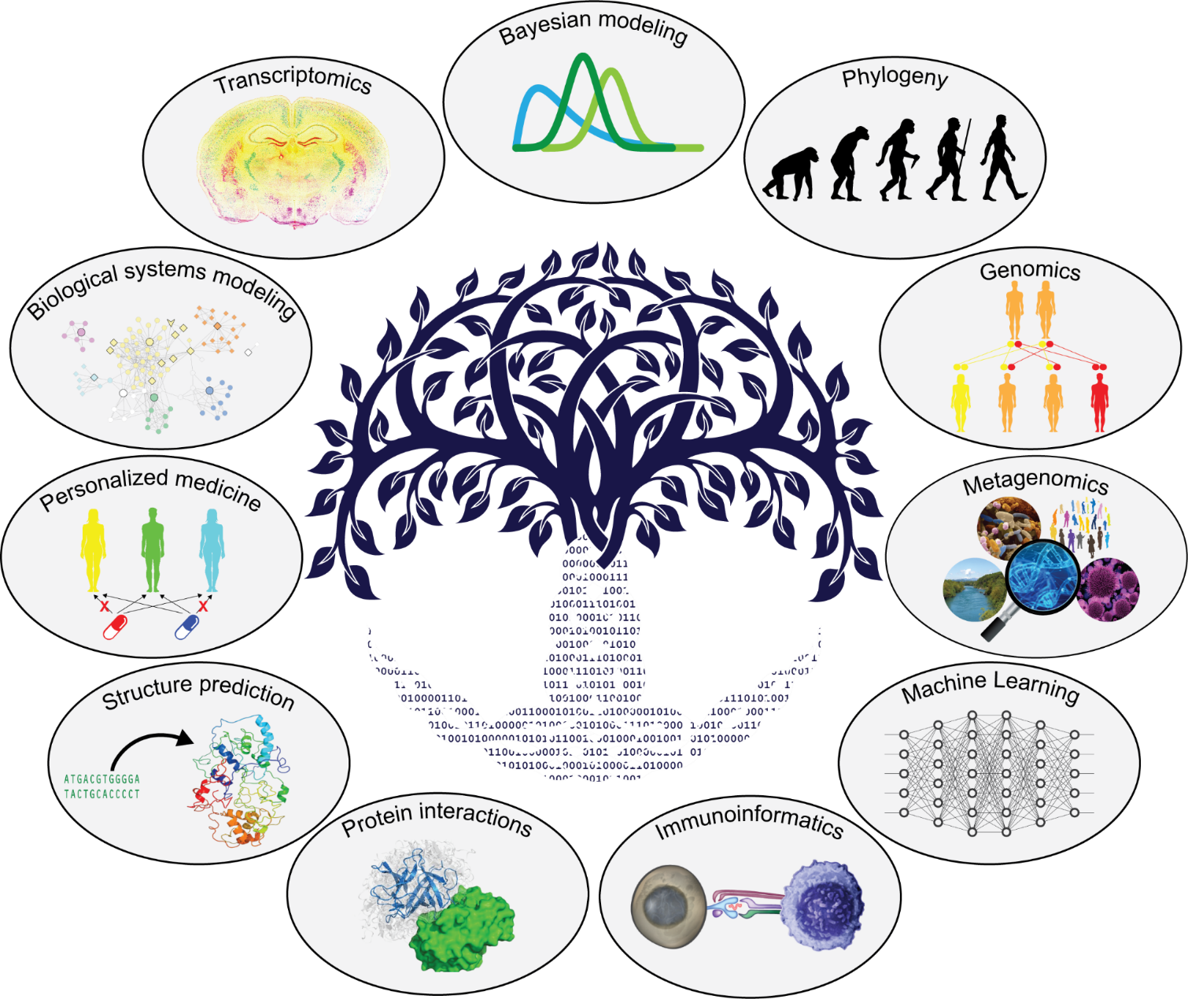
Molecular clock dating of a zoonotic event: From pandemic to the common cold
Anders Gorm Pedersen,
Professor,
Section of Bioinformatics, Dept. Health Technology
Technical University of Denmark

Slide 31
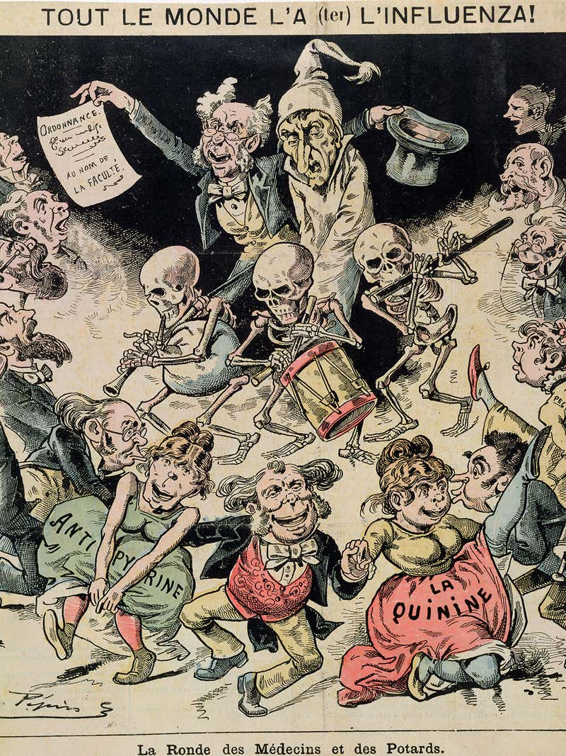
Russian Flu
1889–1892 flu pandemic, also known as the "Asiatic flu”
First reported in the Central Asian city of Bukhara in the Russian Empire, in May 1889, with up to two-thirds of the local population dying
In four months it had spread throughout the Northern Hemisphere.
Deaths peaked in
Saint Petersburg on 1 December 1889
In the United States 12 January 1890
Killed about 1 million people worldwide.
Commonly believed to be caused by an Influenza virus

Slide 32
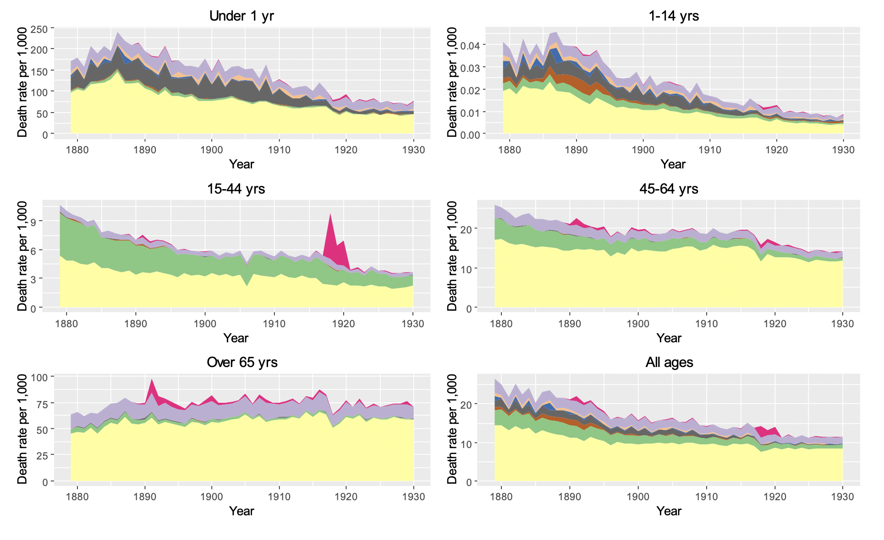
Russian Flu
Lone Simonsen group investigated historical records for Denmark (“Ugelisterne”) around 2010
Model-based estimates of mortality along with those caused by other important infectious diseases: measles, pertussis, diphtheria, and diarrhea
High attack rate: 40% to 75%
High(ish) mortality:
Average about 0.4%
Higher among elderly
Many features not quite fitting influenza hypothesis: death more widespread among elderly, symptoms different, …
Put project aside without publishing

Slide 33
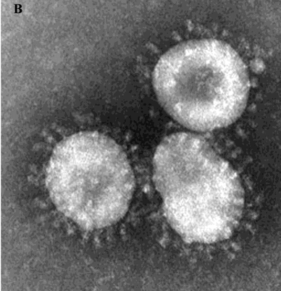
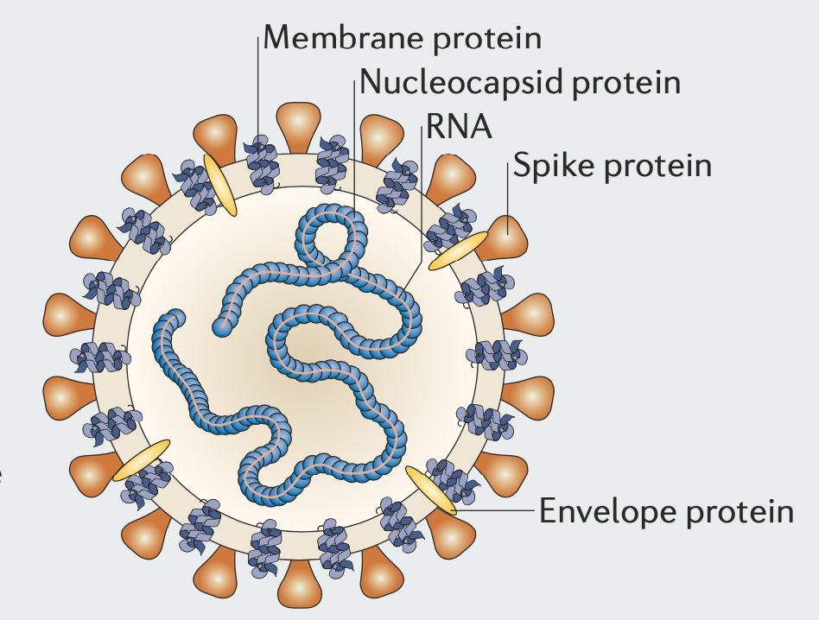

Slide 34
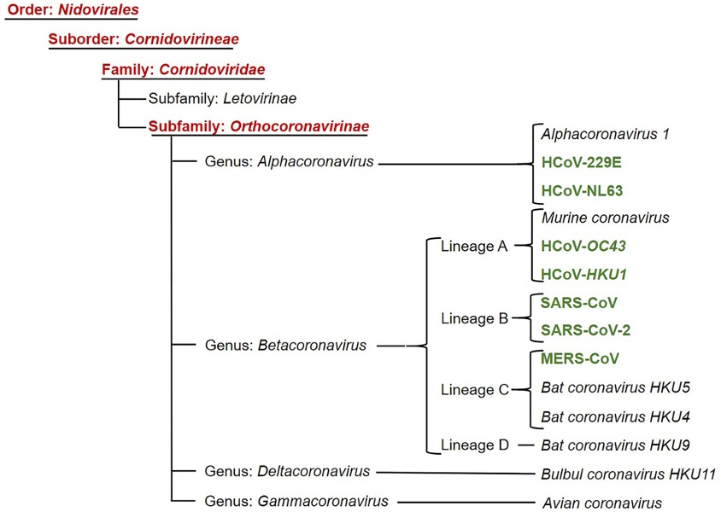
Corona virus taxonomy
First discovered and named in the 1960s
Large family of viruses that usually cause mild to moderate upper-respiratory tract illnesses, like the common cold
Human corona viruses discovery timeline:
229E (1966)
OC43 (1967)
SARS (2003, 10% case fatality)
NL63 (2004)
HKU1 (2005)
MERS (2012, 35% case fatality)
SARS-CoV-2 (2019, 1-3% case fatality)

Slide 35
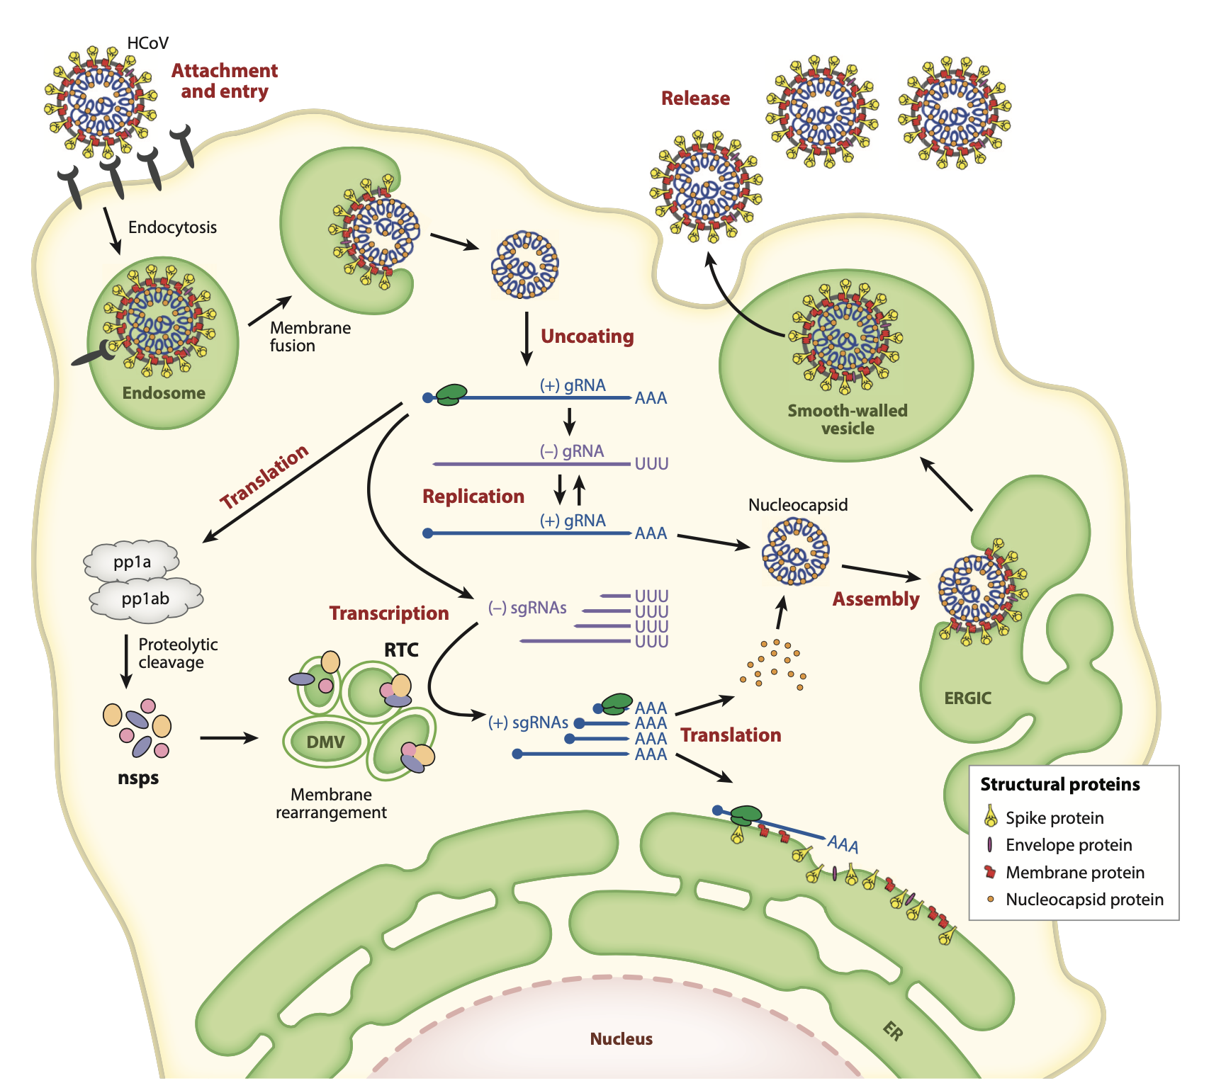
Replication cycle of
human coronaviruses
Enveloped viruses with positive-sense single-stranded RNA genome
The genome size of coronaviruses ranges from approximately 26 to 32 kilobases, one of the largest among RNA viruses.

Slide 36
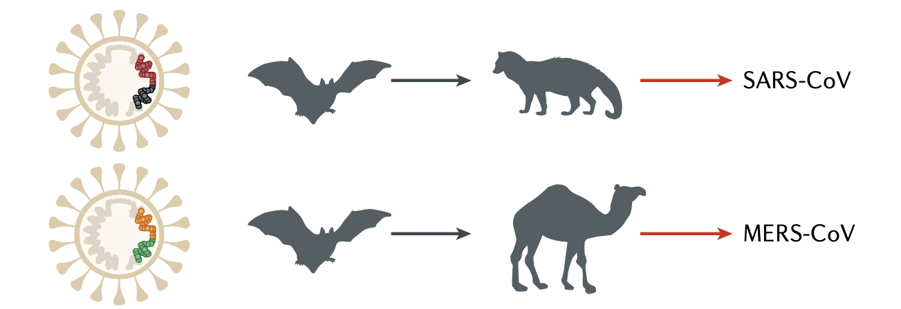

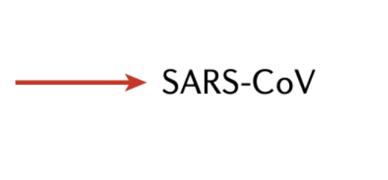
Pandemic corona viruses are zoonotic
?
2

Slide 37
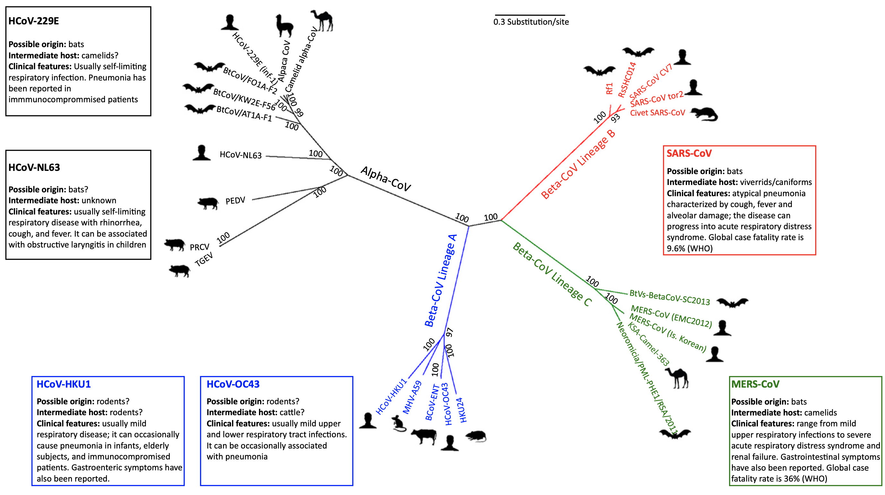
Non-pandemic human corona viruses are also zoonotic

Slide 38
Closest relative of non-pandemic corona virus OC43 is a cow virus

Slide 39
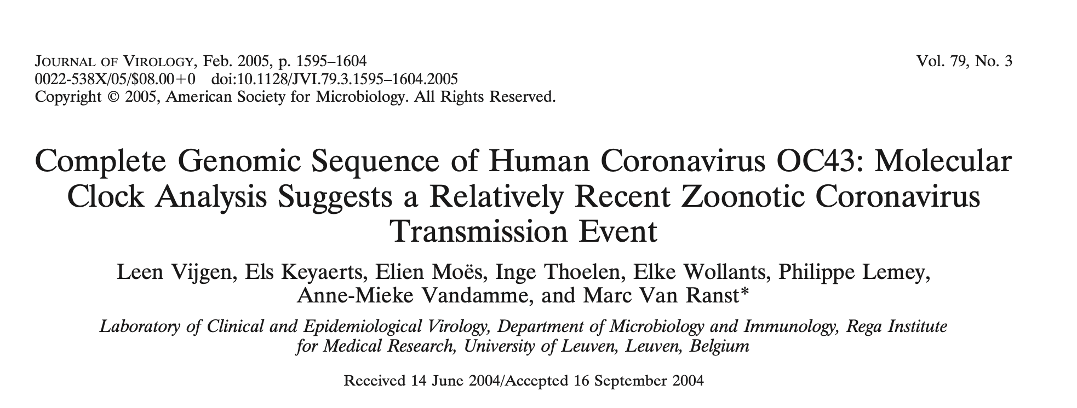

Slide 40
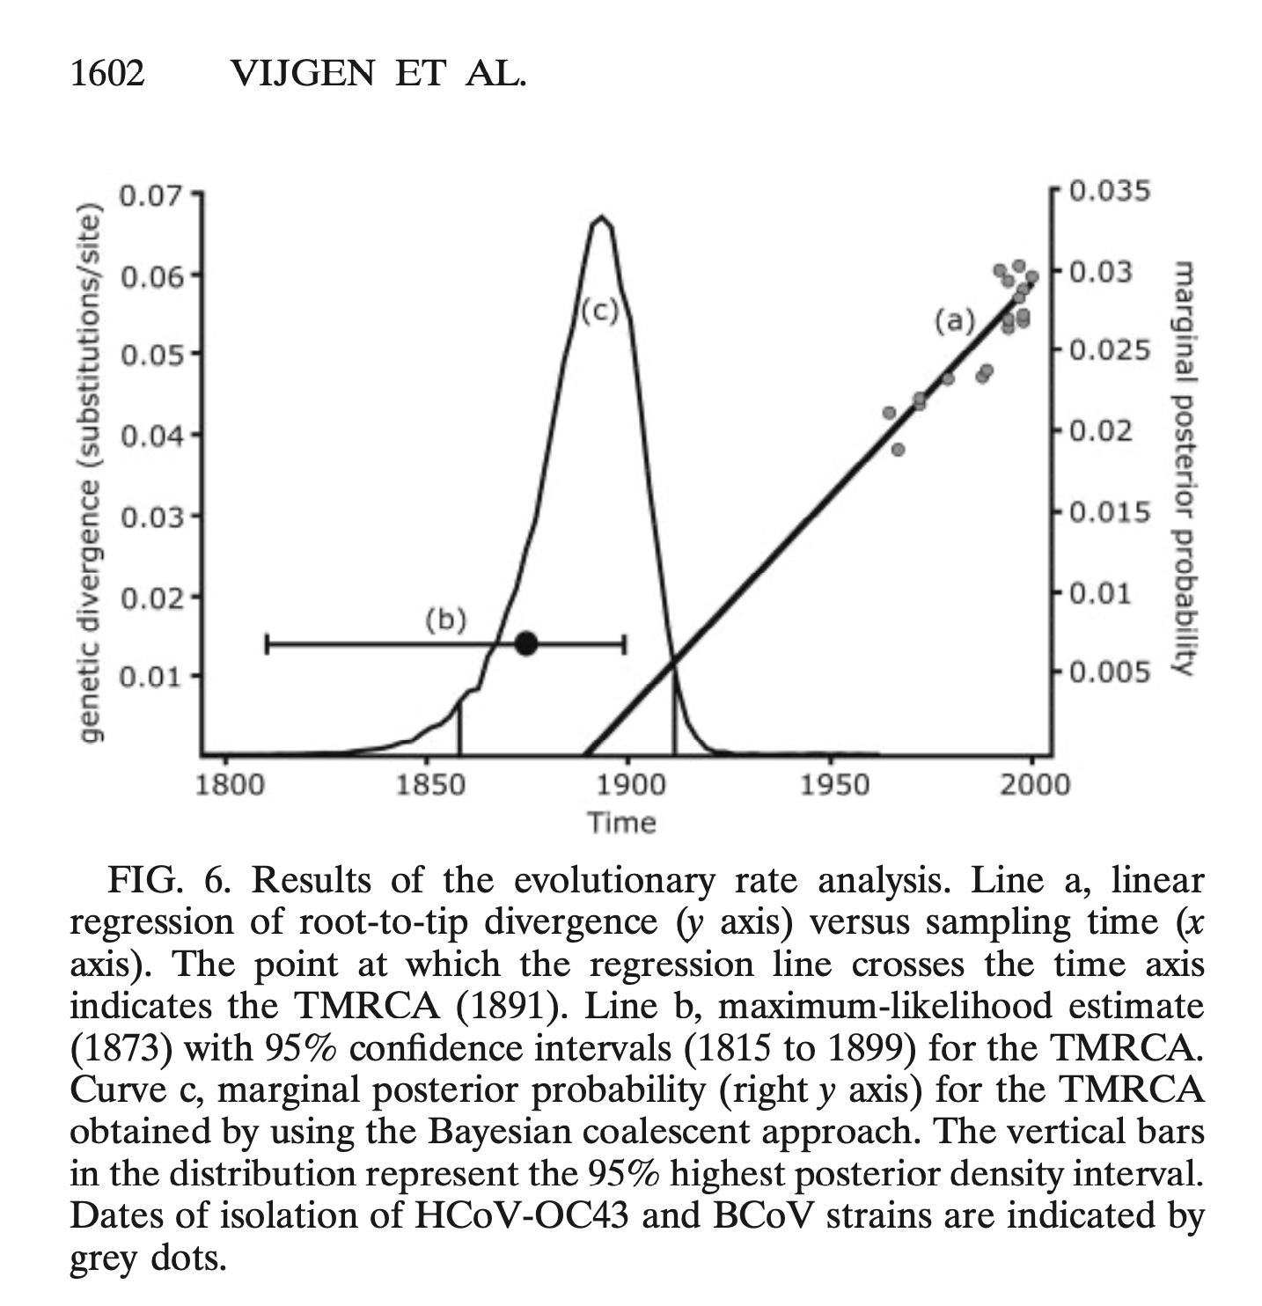
Hypothesis about OC43 as cause of 1889 pandemic
“Interestingly, around the period in which the BCoV interspecies transmission would probably have taken place, a human epidemic ascribed to influenza was spreading around the world.
Absolute evidence that an influenza virus was the causative agent of this epidemic was never obtained, due to the lack of tissue samples from that period.
However, postepidemic analysis in 1957 of the influenza antibody pattern in sera of people who were 50 to 100 years old indicated that H2N2 influenza antibodies might have originated from the 1889–1890 pandemic.
However, it is tempting to speculate about an alternative hypothesis, that the 1889–1890 pandemic may have been the result of interspecies transmission of bovine corona-viruses to humans, resulting in the subsequent emergence of HCoV-OC43”.

Slide 41
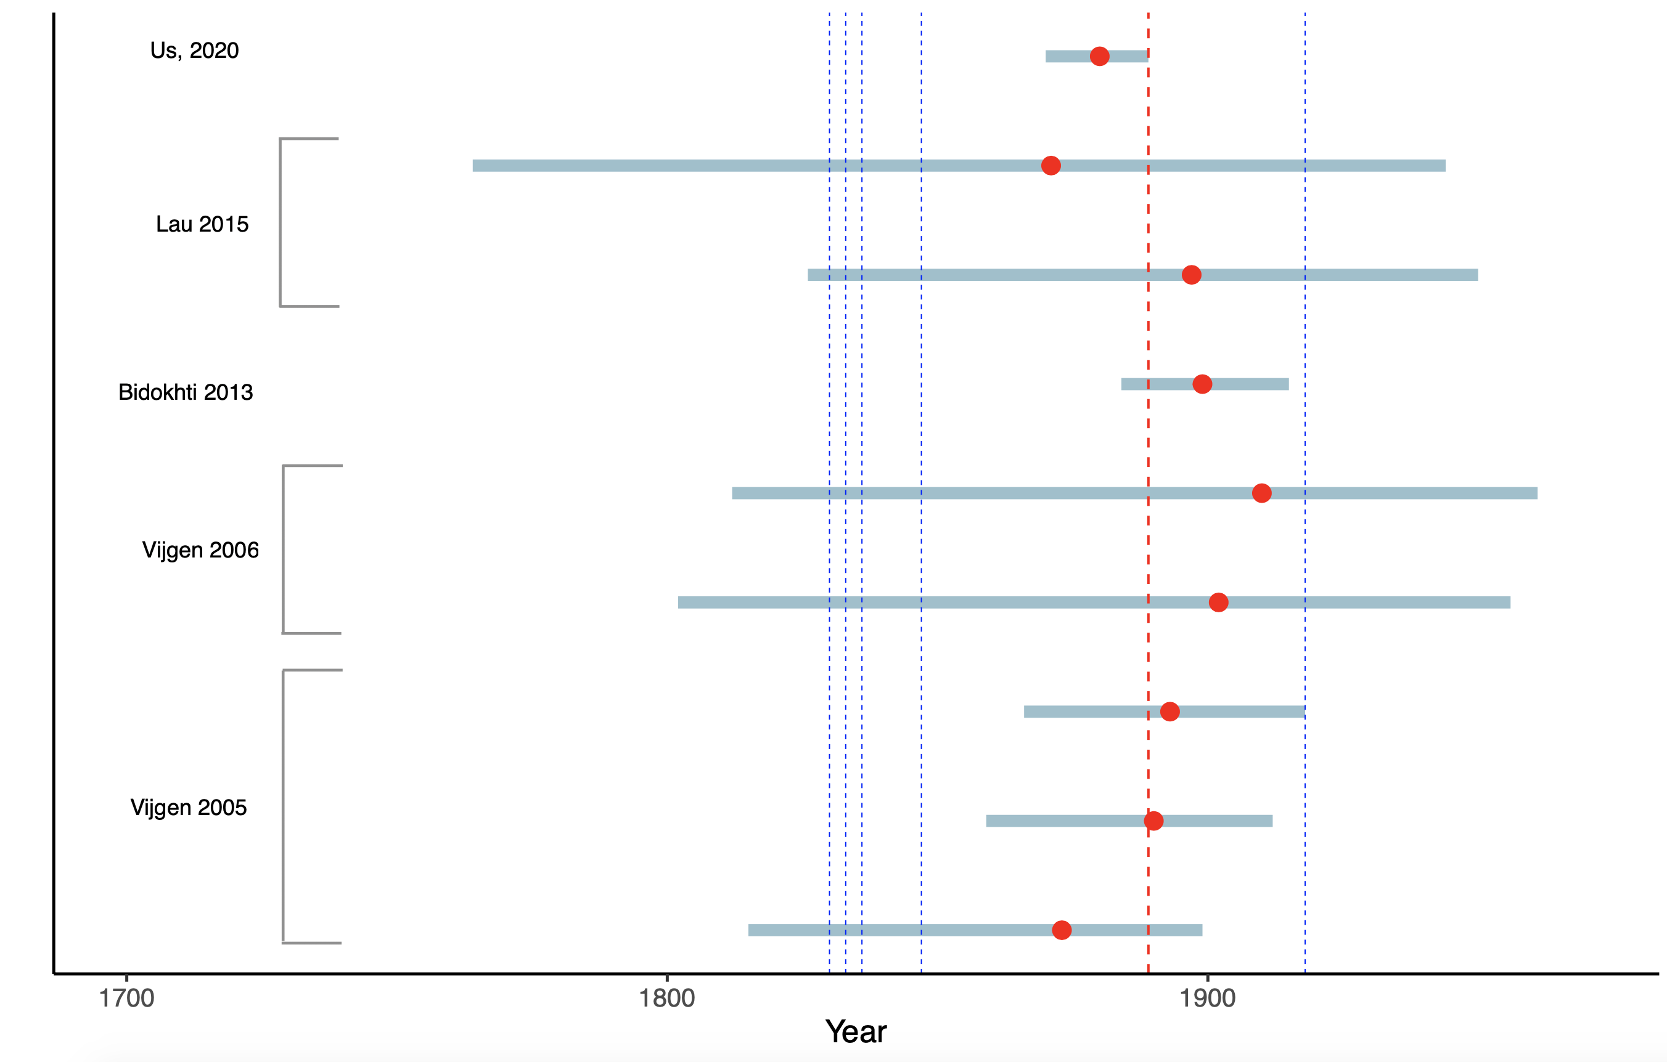
Estimation of age of OC43 / BCoV ancestor in other people’s work

Slide 42
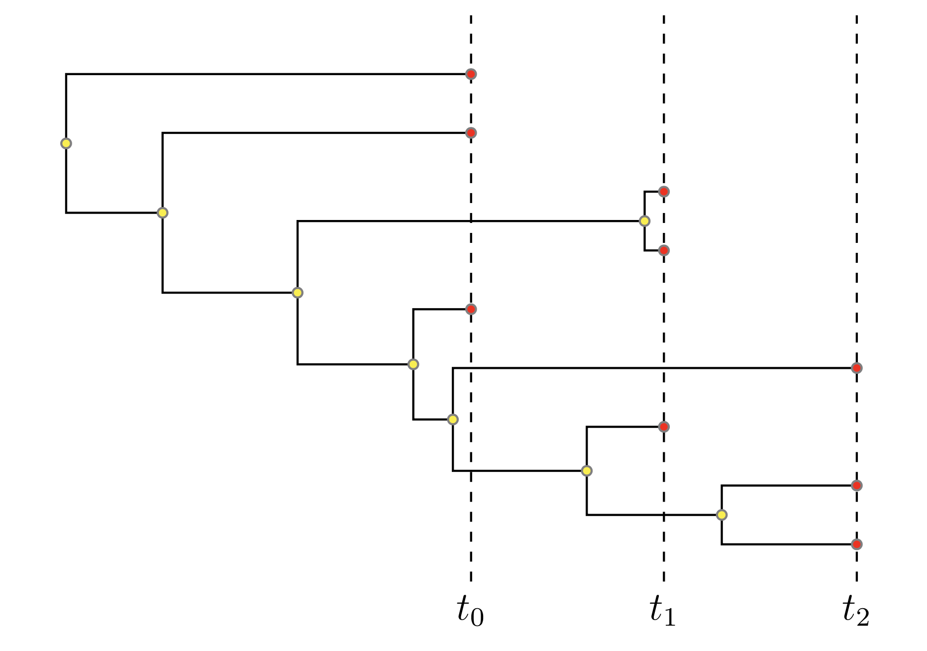
Bayesian phylogenetics:
Estimating the age of ancestral nodes in tree from dated samples
Virus sequences evolve rapidly
Measurable evolution over short time spans (months or years)
“Heterochronous” (non-simultaneous) samples allow us to infer absolute rate of evolution
Knowing the rate allows us to infer the age of ancestral nodes in tree
We collected large set of whole-genome sequences for OC43 and BCoV with known sample dates

Slide 43
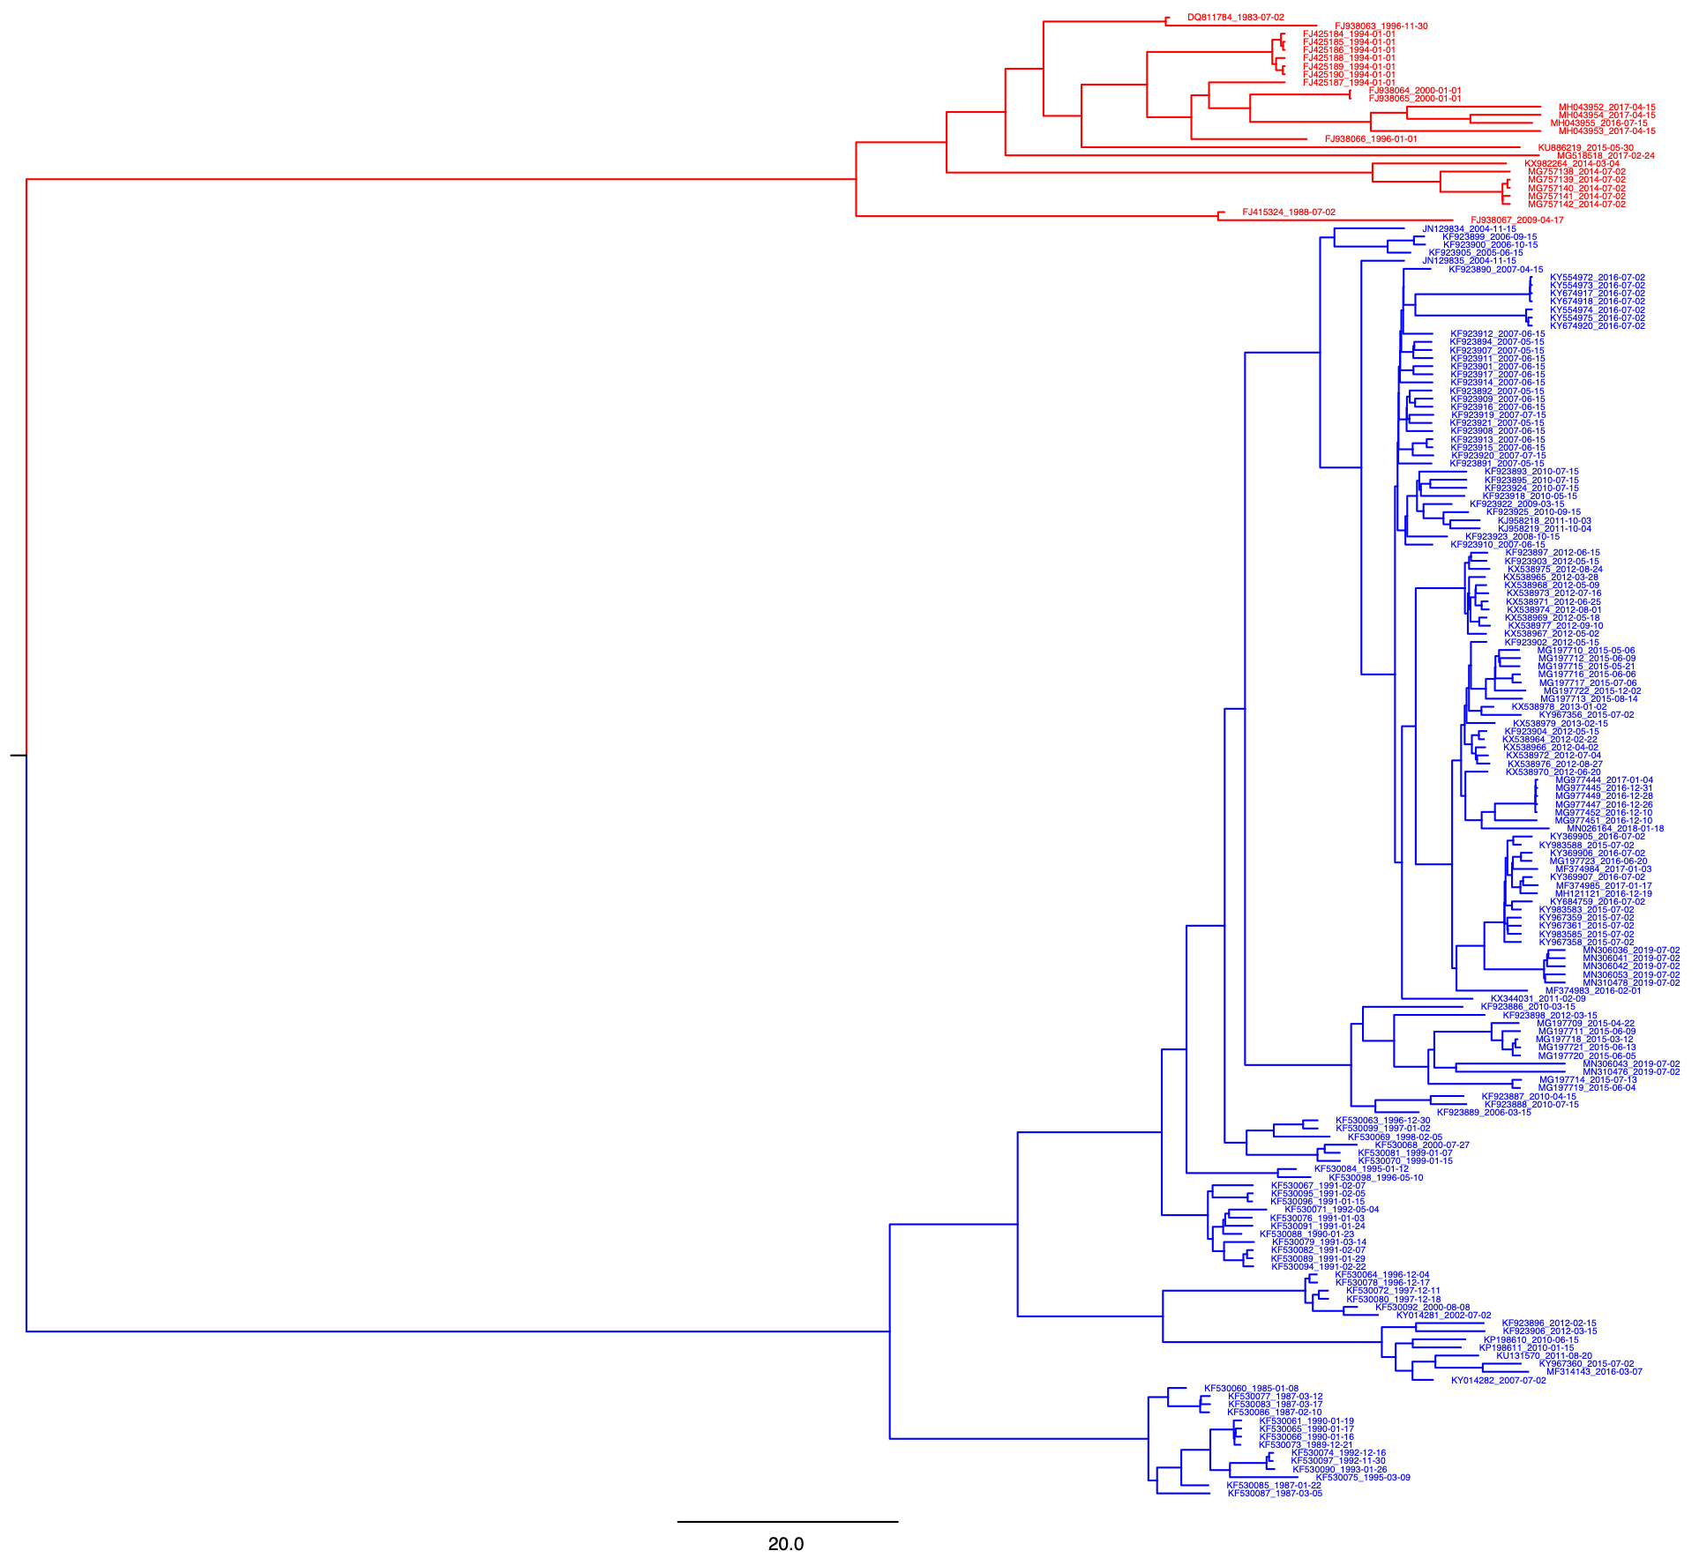
Estimating date that OC43 corona virus jumped from cows to humans
Bovine Corona virus
Human OC43 virus
Common ancestor
around time of species jump

Slide 44
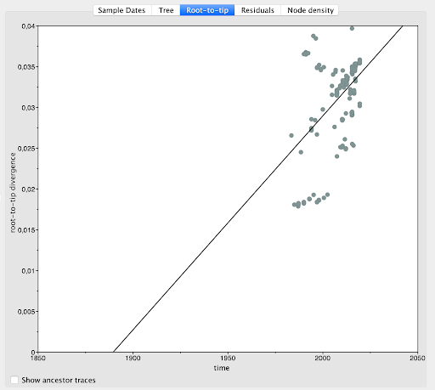
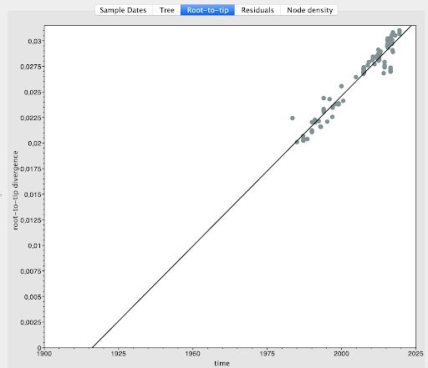
Bayesian phylogenetics:
Removal of recombinant sequences
Recombination detection tool RDP4 was used to detect and remove sequences containing possible recombination events.
Final dataset consisting of 112 HCoV-OC43 and 24 BCoV sequences.
Removal of recombinants resulted in a strong improvement of temporal signal
Before: r2=0.23. After: r2=0.93)

Slide 45
Timing: very close to 1889, with little uncertainty

Slide 46
Different model assumptions lead to same estimated date

Slide 47

Timing: very close to 1889, with little uncertainty

Slide 48
1889 “Russian Flu” was early corona virus pandemic, now evolved into seasonal cold virus
Bovine Corona virus
Human OC43 virus

Slide 49
Acknowledgements
Amanda Gammelby Qvesel¹ , Maarten van Wijhe¹, Alex Vincent Thorn¹, Cécile Viboud²,
Robert Taylor¹, Viggo Andreasen¹, Lone Simonsen¹, Anders Gorm Pedersen³
¹Department of Science and Environment, Roskilde University, Denmark
²Fogarty International Center, National Institutes of Health, USA
³Department of Health Technology, Section for Bioinformatics, Technical University of Denmark

Slide 50
Understanding health data Perspectives from epidemiology research
Thea Kølsen Fischer Professor, Nordsjællands Hospital Telemedicine solutions – building our pandemic preparedness and response resilience
Digital Tech Summit 2022

Slide 51

Thea Kølsen Fischer,
Professor, Director of Research
Dept of Research, Nordsjællands Hospital
Notes:
Title Slide

Slide 52



Paradigm Shift

Slide 53
Paradigm Shift

Slide 54



Influenz-er Model
HaH patient (Hospital at Home)
VEC (Virtual Epidemi Center)

Slide 55

Patient safety
Clinical data
Triage
Data handling

Slide 56
Development & Testing
Technology
design
Pilot test
Training of
staff
Feasibility
Proof of concept
Evaluating effect

Slide 57
Development
Technology +
SOP design
In-hospital
Pilot test
Training of staff
Feasibility
Proof of concept
N = 13
N = 7
25/5 2021 – 27/1 2022
28/2 – 06/4 2022
25/10 2022 -
Notes:
Det var en kort intro til hjemmeindlæggelsesmodellen.
Nu
Jeg vil kort zoome ud og vise jer hvordan modellen er blevet afprøvet og hvilke erfaringer vi har fået.
KLIK Vi har Designet teknologi – en app til pt og et system til hospitalet. Vi har også udarbejdet standard arbejdsgangene med fokus på PS. I denne fase har der været meget tæt samarbejde mellem teknologi udviklere, forskere og kliniske medarbejdere.
KLIK I en pilot test afprøvede vi teknologien og arbejdsgangene (DELELEMENTER) med 13 pt’er på afdelingen som IKKE forlod hospitalet . her har vi testet brugerfladen både for pt og personalet samt den organisatoriske set up i projektet. – både i dv, av og nv.
Vi har samlet erfaringerne og forbedret arbejdsgangene og teknologien og justeret vores forskningsprotokol og har haft en ekstra indsats ifht at sikre at alle på LIA var trygge ved de nye arbejdsgange.
KLIK Nu er vi i gang med et feasibility studiet, hvor vi tester ALLE ELEMNTER af modellen og hvor pt rent faktisk kommer hjem. Det er nu at vi finder ud af om det er acceptabel og sikker model for patienterne.

Slide 58
Design
App
VEC
SOP
Implementation
Pilot
Feasibility
Effectevaluation
RCT
The process (as imagined)
2020
2021
2022

Slide 59
Design
App
VEC
SOP
Implementation
Pilot
Feasibility
Effectevaluation
RCT
DONE
The process (as imagined)
2020
2021
April 2022
2022
2023?
Notes:
Det samlede brugertest forløb strækker sig over perioden fra den 25/5 2021 til den 27/1 2022.
Fase1 Initieringstest, Testperiode: 25/5 – 21/8 2021
Formål: Tidlig eksplorativ brugertest af systemet, der har til formål hurtigt at få feedback fra brugere og få initieret optimere designløsninger.
Fase2 Struktureret brugertest, Testperiode: 23 - 27/8 2021
Formål: Validering af systemets vitale funktioner (app og MC) og patientsikkerhed. Denne foregår i testmode med anvendelse af fiktive data, da disse kan modelleres til aktiv udførelse af alle define-rede test scenarier.
Fase 3a Home@Hospital Light – brugertest træning, Testperiode: 30/8 – 11/11 2021
Formål: Brugertest-træning for plejepersonale inden den egentlige 24/7 brugertest. Dette med sigte på at afklare evt. manglende eller uhensigtsmæssige virtuelle afdelingsrutiner i LIAs organisatoriske hverdag i dagstid.
Fase 3b Home@Hospital, Testperiode: 12/11 2021 – 27/1 2022
Formål: Brugertest i driftsmiljø med deltagelse af allerede indlagte testpatienter, der i tillæg indlæg-ges virtuelt 24/7. Fysiske rutiner oversættes til virtuelle under indlæggelsen. Det gælder f.eks. for kliniske målinger af patientdata og stuegange, samt kommunikation via app og MC.

Slide 60
Results: Pilot og Feasibility
Userfriendly technology
Highly flexible
Patient empowerment
”Great out, much better home”
Happiness with the system
More time for training
OBS New competences (digital healthcare)
Support 24/7 = comfort, safety

Slide 61
Perspectives:
< 2-4 months: a new, well-documented, safe and effective home-hospital model and offer to moderately ill epidemic Danish patients
<6 months: model role-out internationally
<2 years: well-documented, safe home-hospitalization offer to patient with other diseases

Slide 62


Perspectives
1.1. 2023
Safe, effective H@H model for epidemic patients
international roll-out
1.6.2024
safe, effective H@H model for many patients & diseases

Slide 63


Thanks for your attention
Dette billede efter Ukendt forfatter er licenseret under CC BY-NC-ND

Slide 64
Understanding health data Perspectives from epidemiology research
Debate Preparing for future pandemics: What did we learn from Covid-19 and what lies ahead?
Digital Tech Summit 2022

